Slide 1
Controller Area Network (CAN) Protocol
Dr. Sachin Argade

Slide 2
CAN Protocol Basics What is CAN?
Robust serial bus standard for automotive and industrial use.
Multi‑master, multi‑node communication (up to 30+ nodes).
Data rate up to 1 Mbps with strong EMI immunity via differential signaling.

Slide 3
Key advantages for EVs:
Real‑time data exchange between BMS, VCU, charger, motor controller.
Error detection/correction ensures reliable safety‑critical messages.​
Simple twisted‑pair wiring reduces harness complexity.

Slide 4
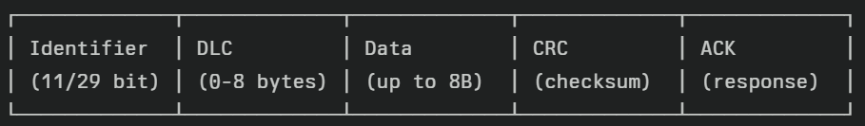
CAN Message Structure
CAN Frame Structure (Simplified)

Slide 5
BMS uses (example messages):
ID 0x100: SOC (%), SOH (%), Max Charge Current, Max Discharge Current
ID 0x101: Cell voltages, pack voltage, current, temperatures
ID 0x200: Fault codes, isolation resistance, contactor states
Priority: Lower ID = higher priority (critical safety messages get low IDs).

Slide 6
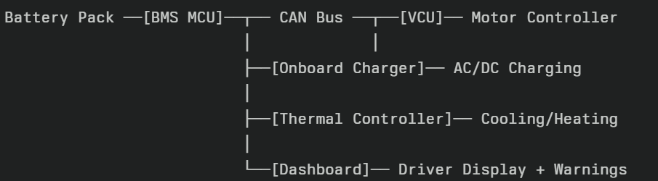
CAN Integration in EV Architecture

Slide 7
Data flow examples
BMS → VCU: "Max discharge current = 200A" → limits torque
Charger → BMS: "Requested charge voltage/current" → BMS approves/rejects
VCU → BMS: "Crash detected" → BMS opens contactors
Safety features: Timeout detection (no message → assume fault → safe state)

Slide 8
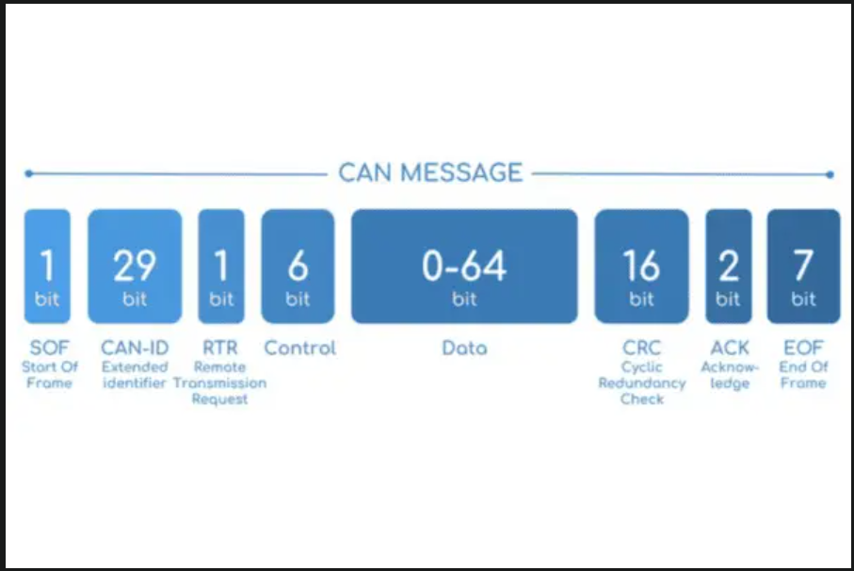

Slide 9
Message ID | Period | Data Bytes | Purpose
0x1806E5F4 | 1000ms | SOC, SOH, Max Chg/Dischg Current | BMS Status to VCU/Charger
0x100 | 100ms | Pack Voltage, Current, Min/Max Cell V | Real-time monitoring
0x101 | 100ms | Cell Voltages (8 cells), Pack Temp | Cell health monitoring
0x200 | Event | Fault Codes, Contactor States | Fault reporting

Slide 10
BMS-to-VCU Communication Example
CAN ID: 0x100 (Battery Status)
Byte 0-1: SOC (%) → 85% = 0x0055
Byte 2-3: SOH (%) → 95% = 0x005F
Byte 4-5: Max Chg A → 50A = 0x0032
Byte 6-7: Max Dischg A→ 200A = 0x00C8

Slide 11
VCU Response:
CAN ID: 0x150 (Torque Request)
Byte 0-3: Requested Torque (Nm)
Byte 4-7: Actual Torque Delivered
Safety Logic: If no BMS message for 2s → VCU assumes 0A limits → limp mode

Slide 12
BMS-Charger Handshake (DC Fast Charging)
Charger → BMS (ID: 0x18DB33F1)
Byte 0-1: Requested Voltage (V)
Byte 2-3: Requested Current (A)
Byte 4: Charge Mode (CC/CV)

Slide 13
BMS → Charger (ID: 0x18FF50E1)
Byte 0: Contactor State (Closed/Open)
Byte 1: Max Allowed Voltage
Byte 2: Max Allowed Current
Byte 3: Fault Status
Protocol: Charger polls every 100ms, BMS responds within 50ms

Slide 14
CAN ID Priority (Lower ID = Higher Priority)
Priority 1 (Critical): 0x080-0x0FF → Contactor commands, Emergency shutdown
Priority 2 (High): 0x100-0x1FF → SOC/SOH, Cell voltages, Current limits
Priority 3 (Medium): 0x200-0x2FF → Temperatures, Balancing status
Priority 4 (Low): 0x300-0x3FF → Historical data, Statistics
Collision Resolution: Arbitration field ensures highest priority message wins bus​

